Slide 1
INTRODUCTION
Here have performance of Customer and Revenue.
AS a part of internship my last project, I have to provide insights to Shield Insurance revenue and customer insights to related teams, which could be consumed by them.
Focusing on different views and understanding performance metrics and KPI’s.

Slide 2

SHIELD INSURANCE
About Company
Shield Insurance company is provider of protection insurance with focusing on customers satisfaction, to covering customers life. They want to be analyze the past data through dashboard.
Shield Insurance operates in different cities to sell policies:
Delhi NCR
Mumbai
Hyderabad
Chennai
Indore
About Project
As a data analyst, my tasks included working with client, Shield Insurance to understand their requirements, interpret data and developed a effective dashboard.
My responsibility is presents supportive insights, they could take more informed decisions.

Slide 3
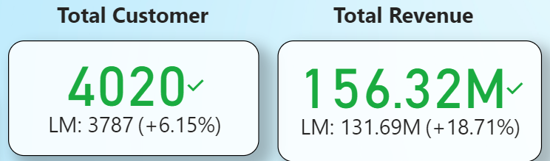
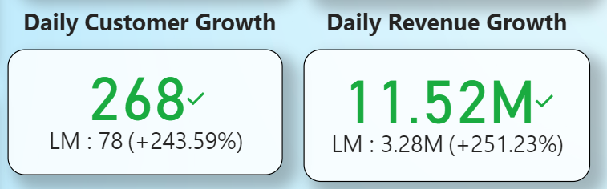
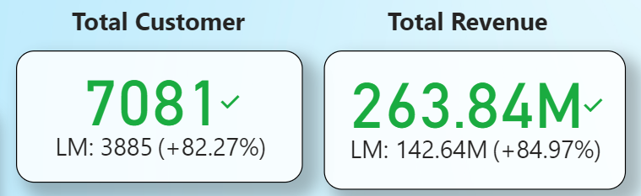
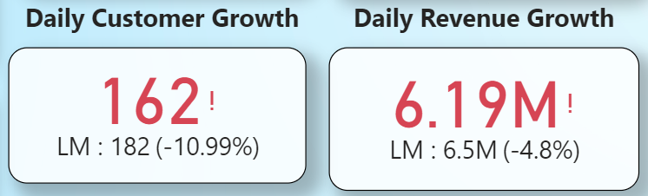
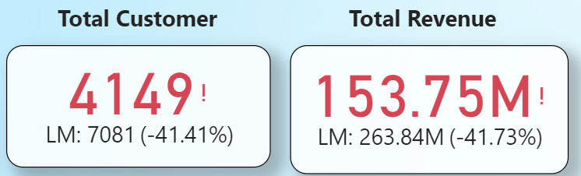
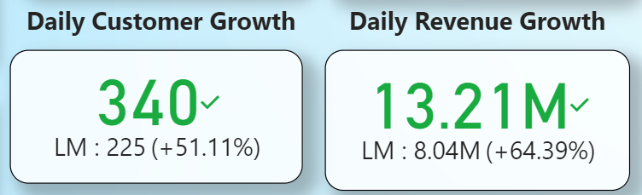
Key INSIGHTS
December
Metrics Analysis
In Dec 2022, here was intensive increase in total customers (4020) and revenue (156M) to the last month (means 6% customers generates 18% revenue growth). This continues to the positive daily growth.
In Mar 2023, here was also notable surge in total customers (7081) and revenue (263M) to the last month. (means 82% customers generates 85% revenue growth). But to the daily growth got declines.
In Apr 2023, here was intensive declined in total customers (-41%) and revenue(-41%) to the last month. But got positive in the both customer and revenue daily growth.
March
April

Slide 4
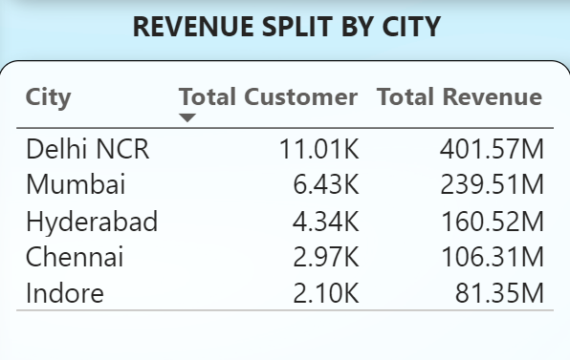
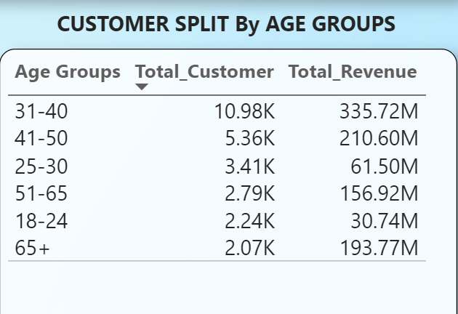
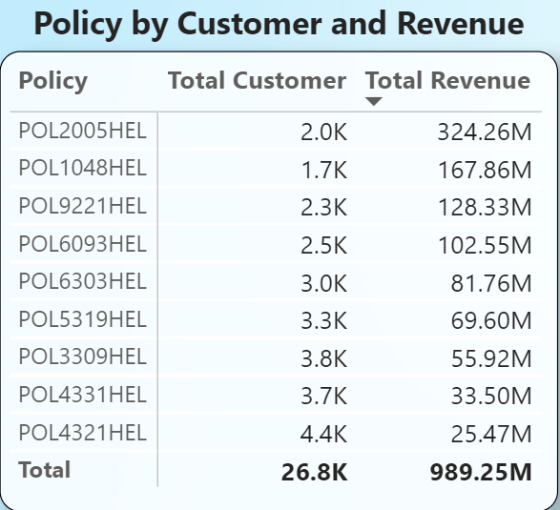
City Analysis
Delhi NCR noted highest customer (11k) and revenue (401M) and generates 40% revenue of total revenue of company, followed by Mumbai with intermediate presence with potential revenue in it.
Hyderabad and Chennai, has smaller customer size despite play important role in revenue.
Age Group Analysis
In age group 31-40 has majority of customer and making highest revenue, followed by the age group 41-50.
Above age of 51, small sized customers base, but play important role in overall revenue.
City Analysis
Policy POL2005HEL generated 324M revenue, whereas POL432HEL is insured by 4.4k customers.

Slide 5
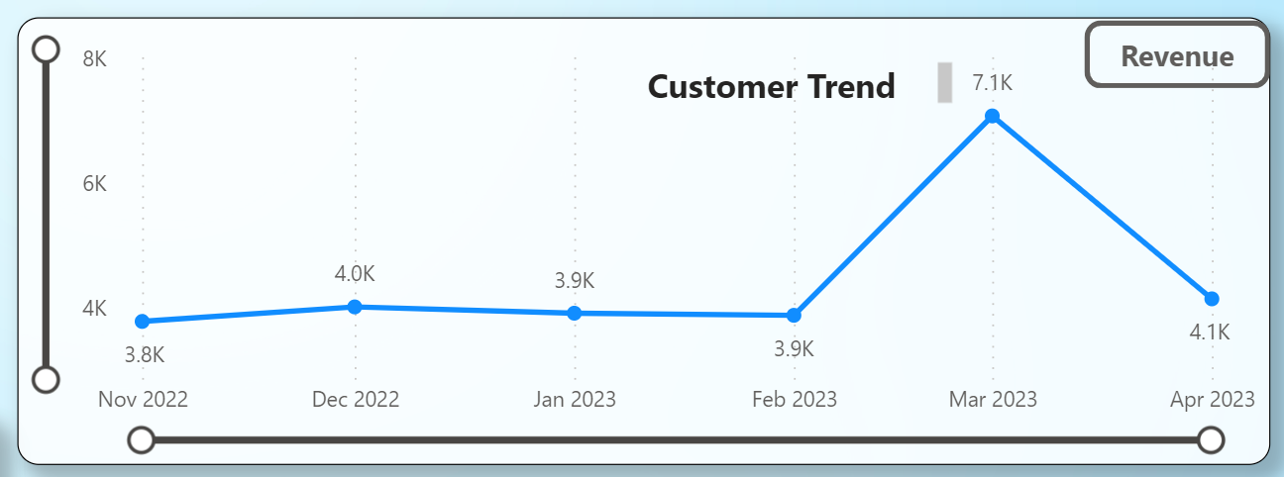
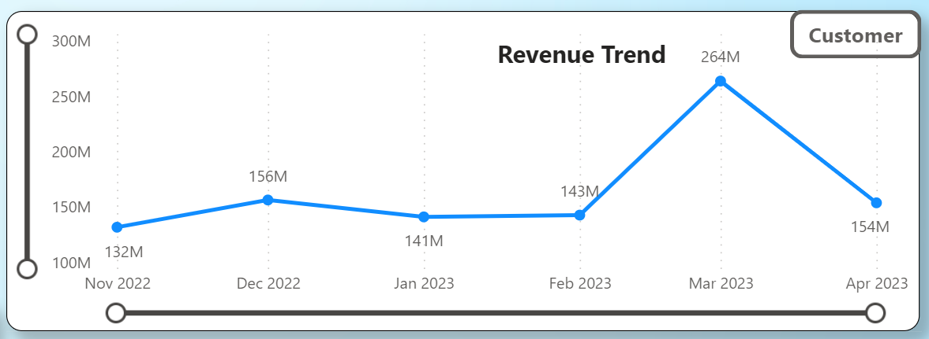
Monthly Trend Analysis
In March 2023, Shield Insurance experienced a unpredictable surge in both customer and revenue trend.
The Total customer hike to 7k and Total revenue hike to 264M significant growth compared with same month in both trend.
In April 2023, Shield Insurance came back on same declining track in customer and revenue negative impact.
Shield team should give attention, how again occurred reduction in both metrics.

Slide 6
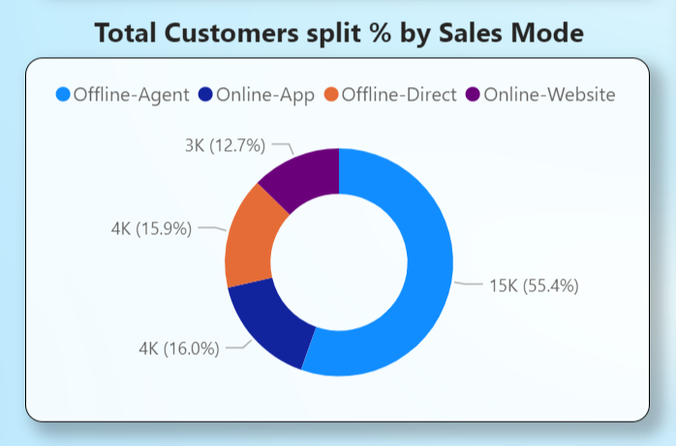
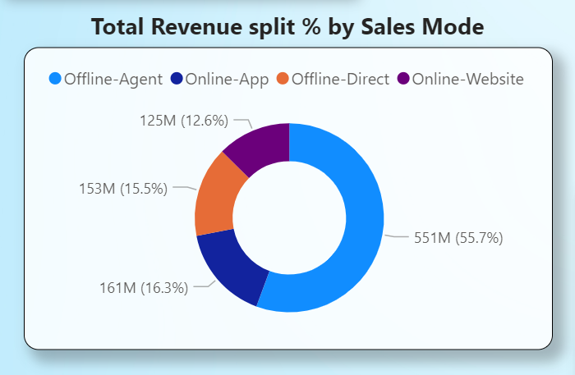
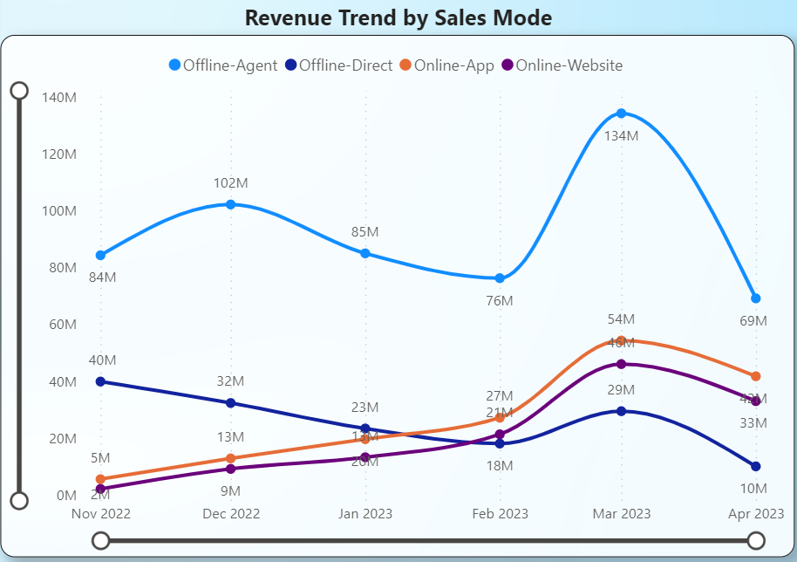
Sales Mode Analysis
Offline-Agent play majority role in policies, 55% of the total customer and revenue contribution with 15k customer and 551M revenue.
That’s indicating, the activeness of direct offline-agent sales, it’s increasing the trust and customers interaction of offline.
In Revenue Trend, offline-direct sales decrease in revenue.
On the other hand, online-app and online-website sales showed intermediately increase in both revenue in overall months.

Slide 7
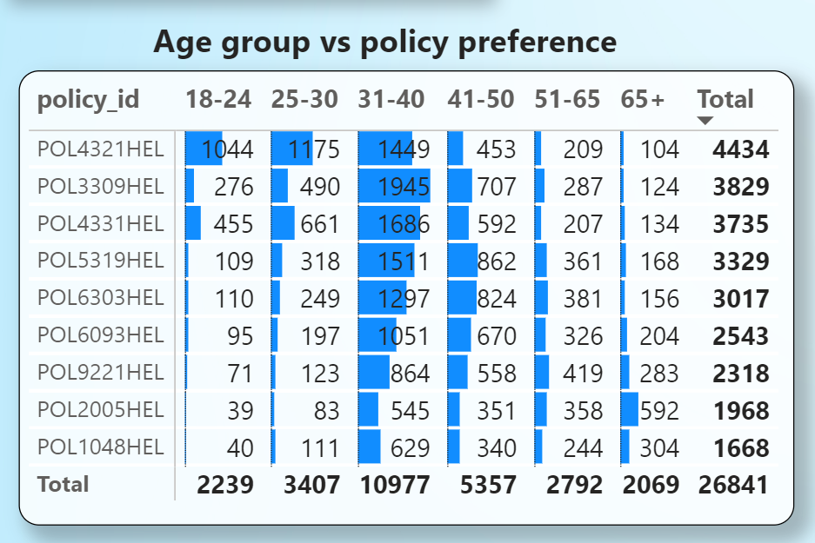
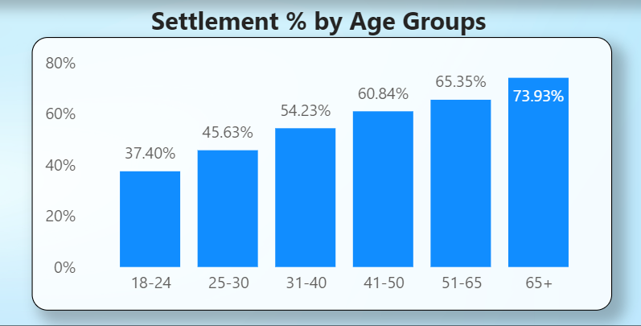
Age-Group Analysis
In the 31-40 age group, the POL3309HEL is a demanded policy among the customers in this group.
Also, in this age group customers prefer most of the policies.
In settlement %, 65+ age group indicates highest settlement with 73%, followed by 51-65 with 65%.
On other hand, 18-24 age group has lowest settlement with 37%.
THANKS YOU…

